Slide 1
机器人与人工智能实验室 Robotics and Artificial Intelligence Laboratory
WELCOME TO

Slide 2
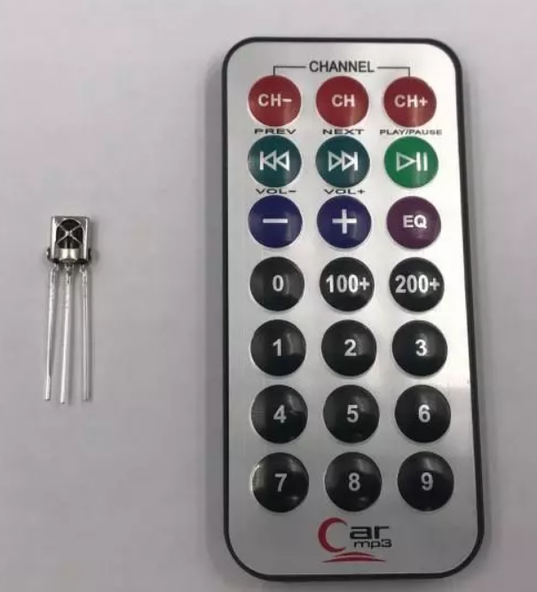
Infrared Remote control
1. Principles
Infrared remote control is mainly composed of infrared transmission and infrared reception.

Slide 3
Infrared Remote controlling
Infrared transmitting and receiving signals are actually a series of binary pulse codes. The high and low levels are changed according to a certain time law to transmit the corresponding information.
To protect it from the interference of other signals during wireless transmission, the signal is usually modulated on a specific carrier frequency (38K infrared carrier signal) and emitted through an infrared emitting diode. The infrared receiver must demodulate the signal and restore it to a binary pulse code for processing.

Slide 4
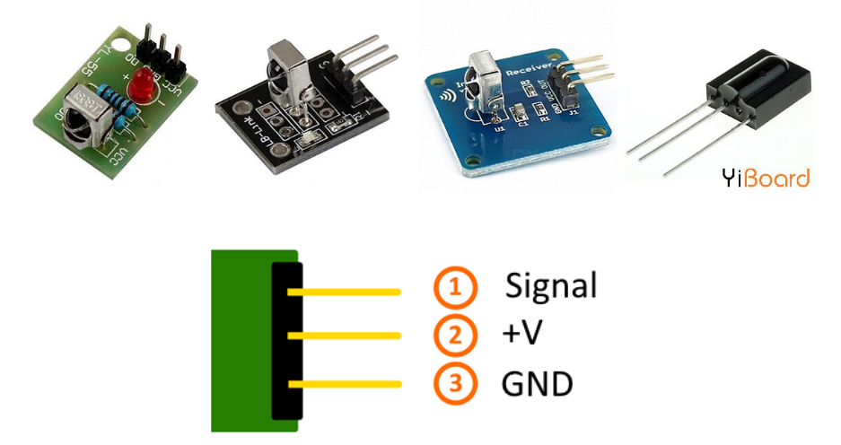
Infrared Remote controlling
These modules have 3 pins for VOUT, VDD and ground, so they are very easy to use in circuits.

Slide 5
Infrared Remote controlling
2. Coding for remote control buttons
To establish a connection between the Arduino and the IR transmitter and receiver, we first need to know the code of each button on the remote control. By pressing each button, a specific signal is sent to the receiver and will be displayed in the serial monitor window.

Slide 6
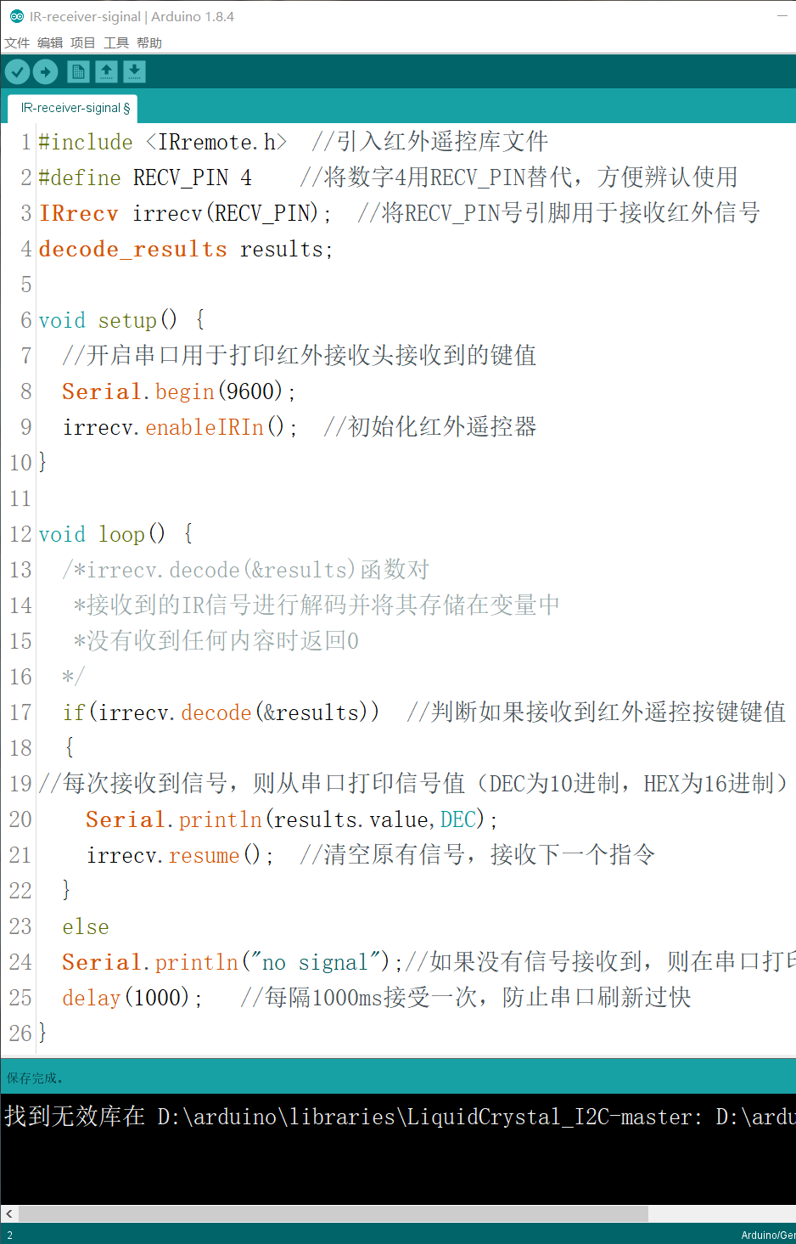
Infrared Remote controlling
The signal cable of the infrared receiver on the cat's motherboard is soldered (at port 4 IO), so there is no way to change it. If you connect the signal line to other IO ports, you only need to change the macro definition in the second line. Change 4 to the number of the IO port you connected.

Slide 7
Infrared Remote controlling
Next

Slide 8
Infrared Remote controlling
Next

Slide 9
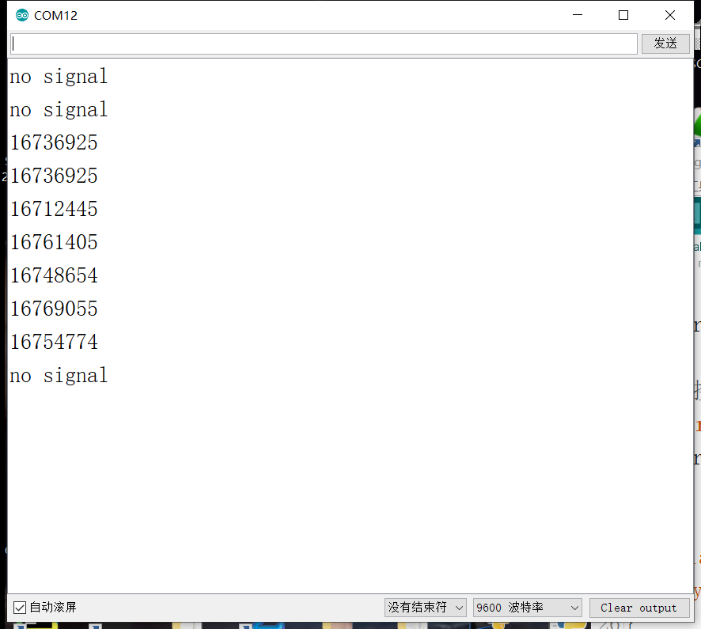
Infrared Remote controlling
Upload this program to the board, open the serial monitor, and then see the corresponding key value of each button.
We can use decimal numbers (DEC) or hexadecimal numbers (HEX). Remember to add 0X in front of hexadecimal numbers.

Slide 10

THANK YOU
林天麟 教授
香港中文大学（深圳）
机器人与人工智能实验室
WeChat: tinlunlam

